Slide 1
Epic Meal Slime:
The Last Supper
Rebecca Tester & Matthew Satterfield

Slide 2
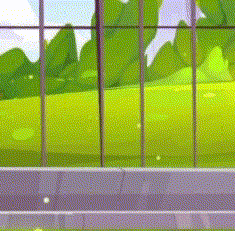
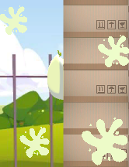
Changes From Feedback
Wall Hit Clarity/Feedback
Additional Visual Liveliness
Quality of Life
Progressive Difficulty
Improved Slime Animation / Additional Squash & Stretch

Slide 3
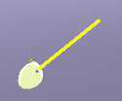
Cut Additions
Customizable Aiming Line / Reticle
Additional Tweening for Menu Panels
Moving Pillars
Options Menu

Slide 4
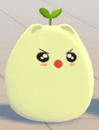
Lessons Learned
Don’t spend hours on one thing—take a break and get back to it later.
Partially finished flexible code can be better than rushed working code in long run.

Slide 5
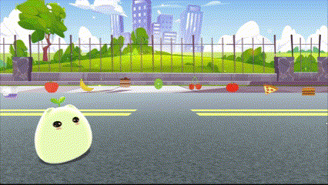
What Went Well
Teamwork!!
Art Style
Tweening
Playtesting

Slide 6
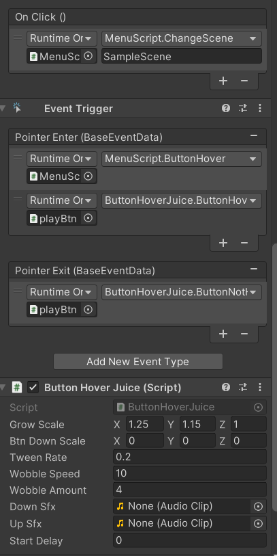


What Didn’t Work Out
More dynamic pillars
Button Inconsistencies / Editing
Moving background slimes

Slide 7
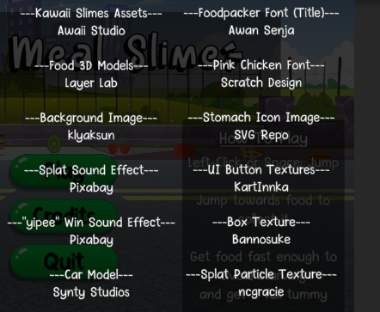
Changes For Next Time
Use prefabs more (like for buttons)
Use more original assets
Less procrastination, spread work out throughout the week

